Slide 1
Project REVIEW
Project Name : WhatsApp

Slide 2
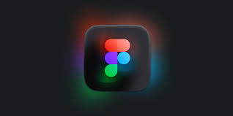
F i g m a
Dylan Field and Evan Wallace began working on Figma in 2012 while studying computer science at Brown University.
Figma is a collaborative web application for interface design.
The feature set of Figma focuses on user interface and user experience design, with an emphasis on real-time collaboration, utilizing a variety of vector graphics editor and prototyping tools.

Slide 3
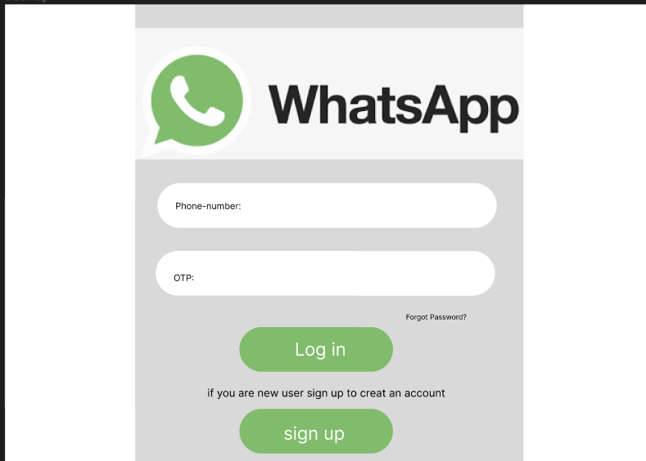
Login Page

Slide 4
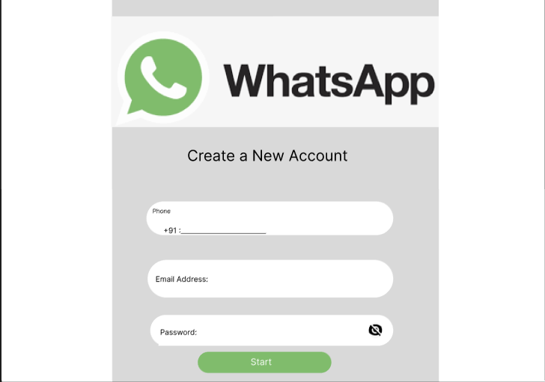
Sign Up

Slide 5
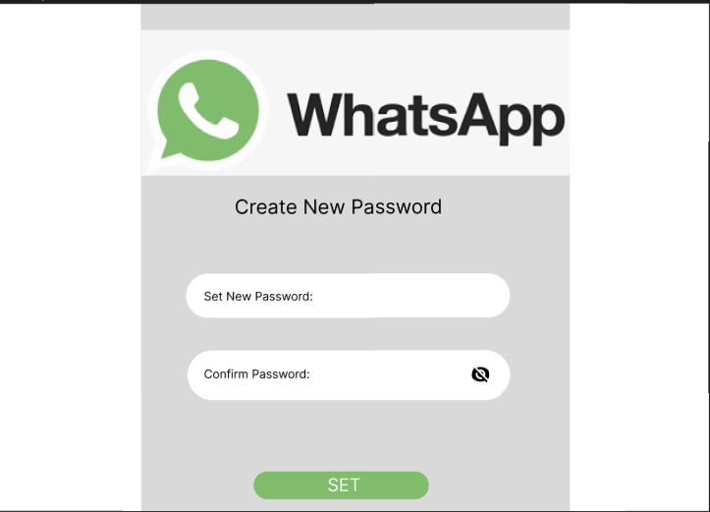
Password

Slide 6
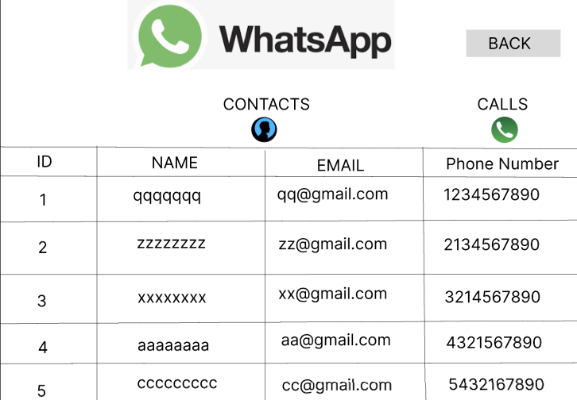
Contacts

Slide 7
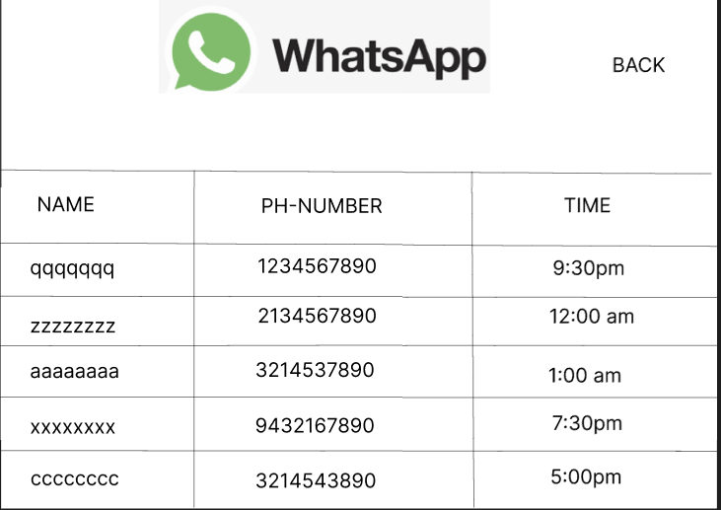
Calls

Slide 8
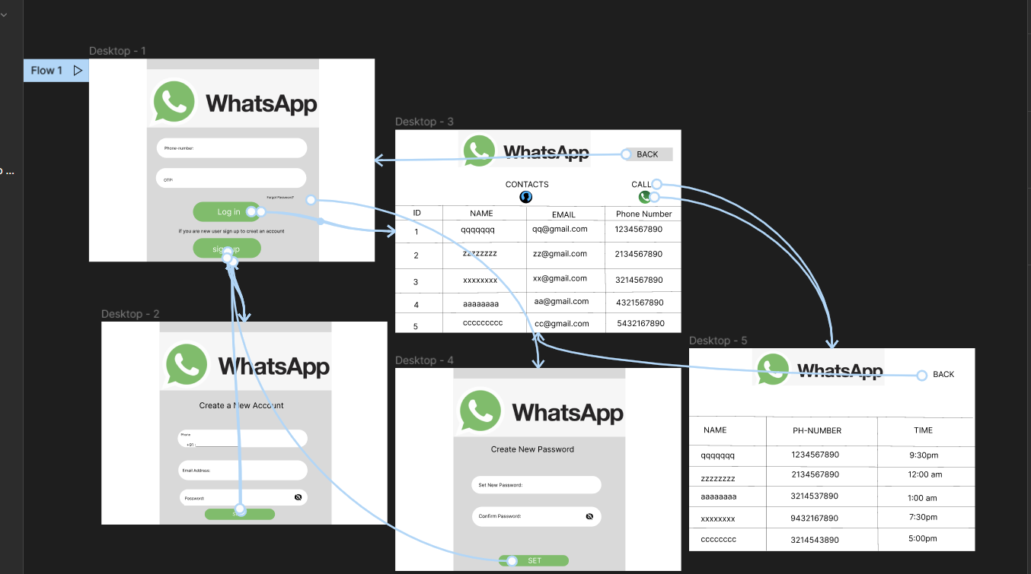
Prototype

Slide 9
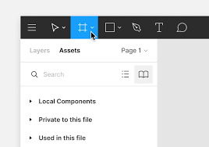
Basic Tools - (1) Frame
The frame tool is what allows you to create frames on the canvas. You can nest frames inside each other as well. Let's start by adding a frame.
To create a frame, either click on the Frame tool in the toolbar or press one of the following keys - F or A

Slide 10
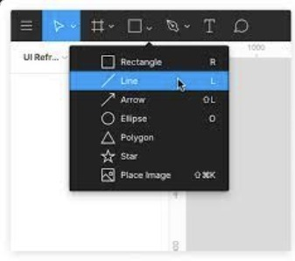
Basic Tools - (2) Shape Tools
You can access all the basic ones via the Shape tools in the toolbar. The shapes available include - Rectangle, Line, Arrow, Ellipse, Polygon and Star.

Slide 11

Text Tool
You can create a new text layer using the Text tool in the Toolbar.
Once you have the Text tool selected, you can create a text layer in the Canvas

Slide 12
Basic Tools - (3) Colour Picker
As with most design tools, you can change the color by clicking the color on the wheel or via the eyedropper tool. Alternatively, you can input the HEX code or choose from one of the preset colors. The opacity value can also be changed from here.

Slide 13
Link
The Link to my Figma Design is :
https://www.figma.com/file/wgxfOQBQh9clxr12uIz6Zv/Untitled?node-id=0%3A1
GITHUB LINK:
https://github.com/jesswinjohnjoy1/Whatsapp.git

Slide 14
Thank You
Team Members:
Jesswin Anto J 727821tuec059
Kanishka A S 727821tuec061
Harini S 727821tuec049
Ishwarya V 727821tuec051
Asvitha K 727821tuec027
CLASS:II ECE A

